Slide 1
Title: Medicine Billing System using Java Swing and iText
Group Member Roll No
1.Om Joshi 111
2.Atharv Lite 116
3.Vishal Biradar 107
4.Gandhar Kanade 112

Slide 2
Introduction:
The Medicine Billing System is a Java-based desktop application.
It provides a user-friendly interface for generating bills for purchased medicines.
Includes a secure login page and functionality to generate PDF bills.
Built using Java Swing for GUI and iText for PDF generation.

Slide 3
Objective:
To develop a simple, standalone application to create medicine bills.
Provide a basic authentication system to secure access.
Allow input of medicine details and customer information.
Generate well-formatted PDF bills for printing or record-keeping.
Promote learning and use of core Java GUI components.

Slide 4
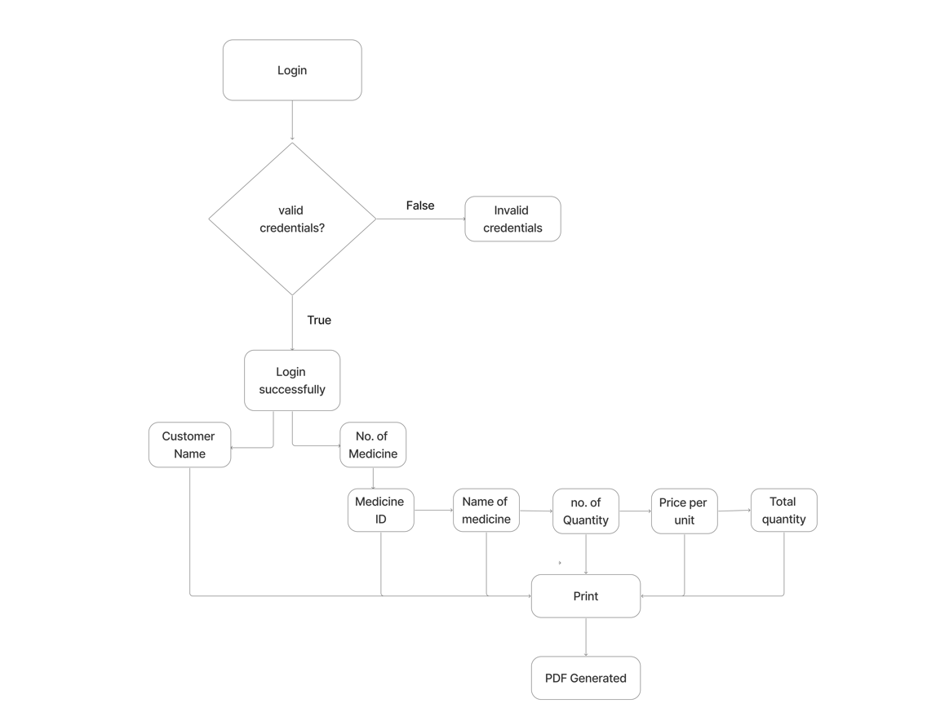
System Architecture:

Slide 5
Working of the System:
1.LoginPage:
-User enters predefined username and password.
-On success, opens the billing app window.
2.MedicineBillApp:
-User inputs customer name and number of medicines.
- Inputs for each medicine:
Medicine ID
Name
Quantity
Price per unit
PDF bill is generated with total cost and customer info.

Slide 6
Java Concepts Used:
Swing Components
- JFrame, JPanel, JLabel, JTextField, JButton, JOptionPane
Event Handling
-Action listeners with lambda expressions
File Handling
-FileOutputStream for PDF output
Third-party Library
-iText for structured PDF creation
Object-Oriented Programming
-Encapsulation of logic in methods and classes

Slide 7
Conclusion:
The application successfully demonstrates:
GUI creation using Swing
Input validation and interaction
PDF generation and formatting
It can be enhanced by:
Connecting to a database
Adding user roles or inventory management
Exporting data to Excel or CSV

